Slide 1
Easify
Team - 3
Neeraj Kulkarni
Janvi Ramani
Anvai Patil
Dhruvil Shah
Varun Patel
Guided By
Professor Henry Wong

Slide 2





Agenda
Introduction
Team members
Problem Statement
Project Description
Personas
Technologies and Design
Front-end
Back-end
Cloud
Architecture
Activity Diagram
Sprint 1-7 recap & Sprint 8
Sprint Backlog
Test Cases
Burndown Chart
Velocity Chart
Completed Committed Ratio
Sprint 8 Results
Retrospective
Future work

Slide 3
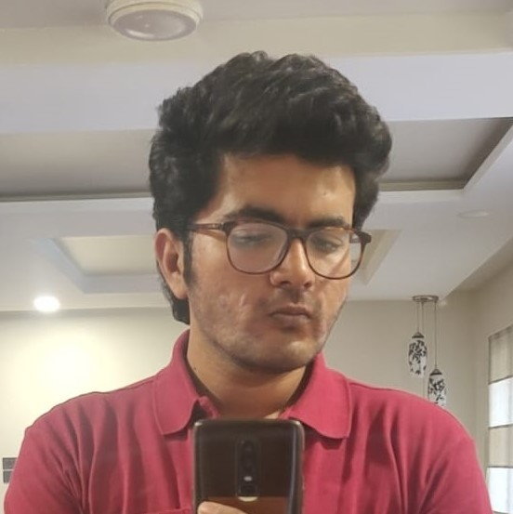



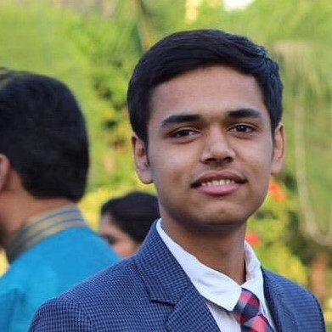
Neeraj Kulkarni Backend Developer
Janvi Ramani
Backend Developer
Anvai Patil
Frontend Developer
Dhruvil Shah
Cloud Engineer
Varun Patel
Full Stack Developer

Slide 4
Problem Statement
Using current scrum application , we can see that there can be end date failure in which people fail to finish the project. There can be situation such that people can be cooperative or committed.
Sometimes daily meetings can frustrate team members and they do not like to perform daily meetings.
Using the remote or onsite project, there can be situation such that one person transfer to another company in middle of project. In this situation, it is difficult to complete project and group will have negative impact.

Slide 5
Project Description
Easify Overview
We are designing an application called Easify. Easify is an application that helps you manage scrum-based projects easily and effectively.
To manage the project, Easify will provide Product Backlog management and Sprint Backlog management features. In addition, users can use Easify’s Share Images and Chat features to share each other work and thoughts.
The Calendar feature is there so that users can plan their work. Users can use the Activity Map feature to understand the project workflow and estimate the users’ workflow.

Slide 6
Personas

Slide 7

Persona - 1:
Name: John
Age: 45
Post: Product Owner
Currently, John is working from home as the owner of the product developed by the team. He is 45 years old and he has a family. It is his duty to ask the scrum master about the progress of the product. It is his responsibility to maintain the system and to determine if the product design will be completed on time. Easify gives him the ability to see the progress and track the work of his team. He can offer suggestions right away through this tool.

Slide 8

Persona-2:
Name: David
Age: 35
Post: Scrum Master
David manages a team of five people. The team isn't located in one city, so offline meetings are impossible. With Easify, he can view the progress of tasks and see the daily or weekly report. Additionally, he can prioritize the task so it can be worked on by the development team.

Slide 9

Persona-3
Name: Olivia
Age: 29
Post: Developer
Olivia is part of a team. She needs to develop a system and report daily to the scrum master. She wants to maintain unity and support within the team. Team members can ask for help from one another. Using Easify, users can share the resources instantly and they don't even have to wait. The app lets them chat and share all the work and discuss their problems. Through this app , they can test and can provide the feedback to programmer.

Slide 10


Slide 11




MVP
Authentication
Register - Login - Logout
Users can Register in the system by entering name, email and password. They can login into the system by entering correct email and password. Users can Log out from the system.
Project
Creation - Settings
Users can create projects by giving unique name and selecting project profile photo. Users can share the projects with other members.
Product Backlog
Users can add items to their product backlog. They can modify the item’s type, priority and sprint. Users can also delete the backlog item from the product backlog.
Sprint - Sprint Backlog
Users can create sprint by giving name and duration. They can add items from product backlog to sprint backlog. Users can also delete the sprint backlog item or also can delete the sprint.

Slide 12

Technologies and Design

Slide 13


Technologies - Front-end
React JS is a front-end JavaScript library for building user interfaces based on UI components. React allows us to create reusable UI components.
HTML, CSS and JavaScript work together to form the front-end design of a website by applying information that affects content, style and interactivity of a site.

Slide 14



Technologies - Back-end
Laravel is a back-end PHP-based framework. It's an entirely server-side framework that manages data with the help of Model-View-Controller (MVC) design.
PHP is known as a general-purpose scripting language. It was among the first server-side languages.
MySQL is an open-source relational database management system. MySQL is ideal for storing application data, specifically web application data.

Slide 15



Technologies - Cloud
Amazon Simple Storage Service (Amazon S3) is a service offered by Amazon Web Services (AWS) that provides object storage through a web service interface. It offers scalability, data availability, security, and performance.
AWS Elastic Beanstalk is an orchestration service offered by AWS for deploying applications which organise various AWS services, including EC2, S3, CloudWatch, autoscaling, and Elastic Load Balancers.
RDS is a distributed relational database service by AWS. It is a web service running "in the cloud" designed to simplify the setup, operation, and scaling of a relational database for use in applications.

Slide 16
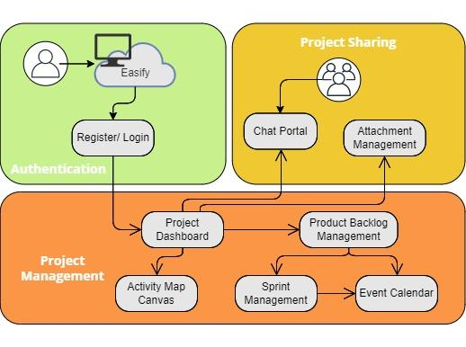
Architecture

Slide 17
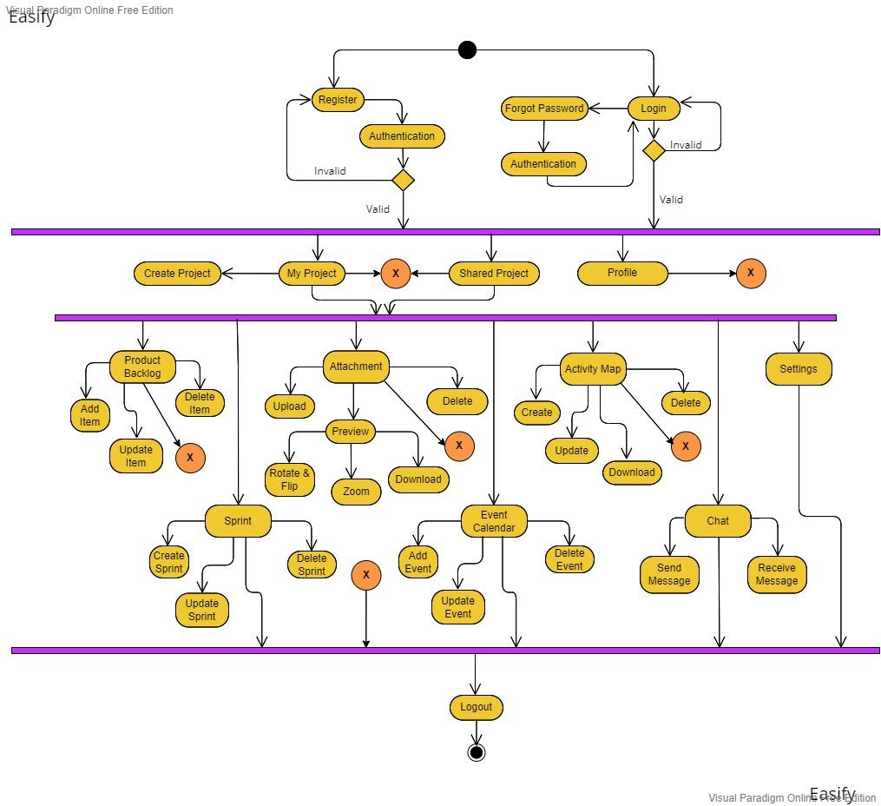
Activity Diagram

Slide 18

Sprint 1-4 Recap

Slide 19
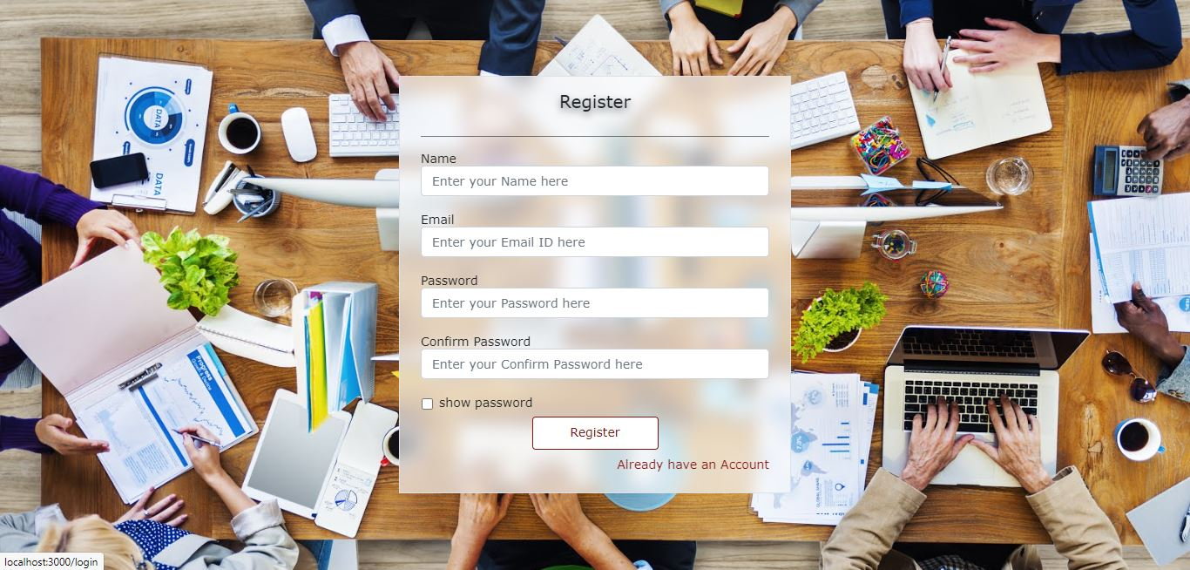
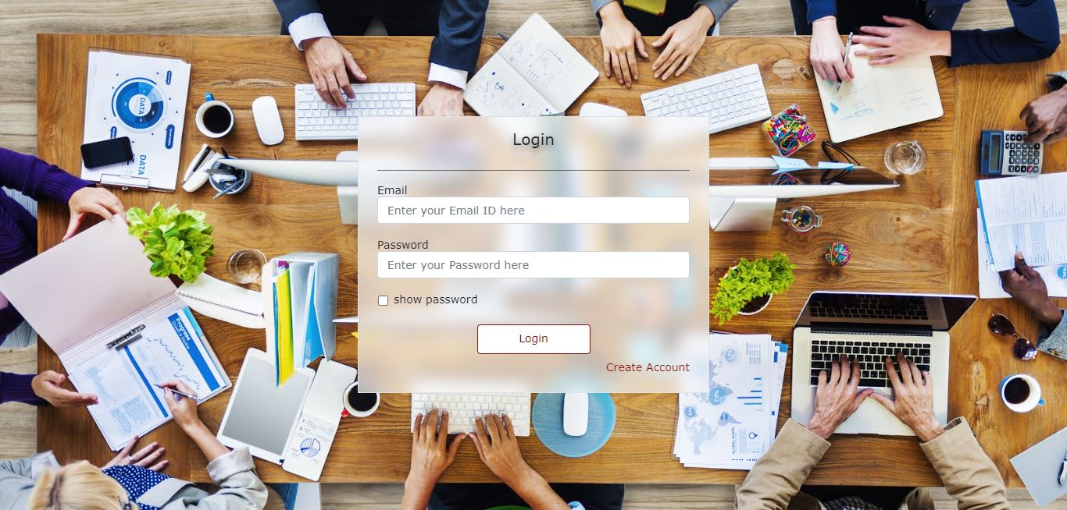
Sprint - 1 (Feb 19 - March 09)
ID | Item | Priority | Story Points | Status
EAS-29 | Research for project topics | High | NA | Done
EAS-30 | Study different tools and technologies for project | Mid | NA | Done
EAS-31 | Create Deliverable - 1 presentation | Mid | NA | Done
EAS-32 | Create Deliverable - 1 video | Mid | NA | Done
EAS-1 | As a new user, I want to register my self so that I can create an account | High | 3 | Done
EAS-3 | As a registered user, I want to login into the system with my email and password so that I can navigate to system's home screen | High | 2 | Done
EAS-5 | As a user, I want to be able to logout from the system so that I can end my session | High | 1 | Done
EAS-38 | Create Wiki Page and upload the Deliverable 1 documents | Mid | NA | Done
Screenshots of the Register Page
Screenshots of the Login Page

Slide 20
Sprint - 2 (March 10 - March 30)
ID | Item | Priority | Story Points | Status
EAS-9 | As a creator of projects, I want to be able to see the projects that I have created so that I can start working on my projects | High | 3 | Done
EAS-10 | As a member of any project, I want to be able to see the projects which are shared with me so that I can see the project details for my work | High | 3 | Done
EAS-11 | As a user, I want to create a project so that I can start the work of the product | High | 2 | Done
EAS-12 | As a creator of the project, I want to be able to share the project with other users so that they can see the project details | High | 5 | Done
EAS-14 | As a creator of the project, I want to be able to set the roles of shared users so that all can know each others roles | Mid | 1 | Done
EAS-44 | Integrate pages with backend | High | NA | Done
EAS-45 | Create presentation for Deliverable - 2 | Mid | NA | Done
EAS-46 | Create video for Deliverable - 2 | Mid | NA | Done
EAS-47 | Update Github Wiki page | Mid | NA | Done

Slide 21
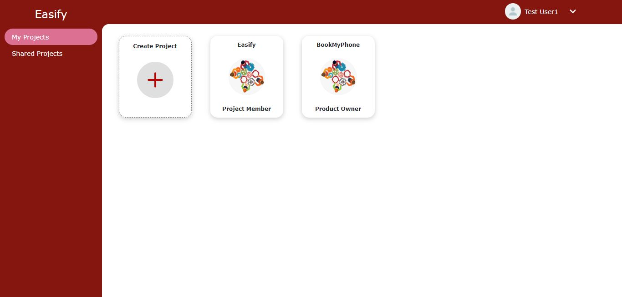
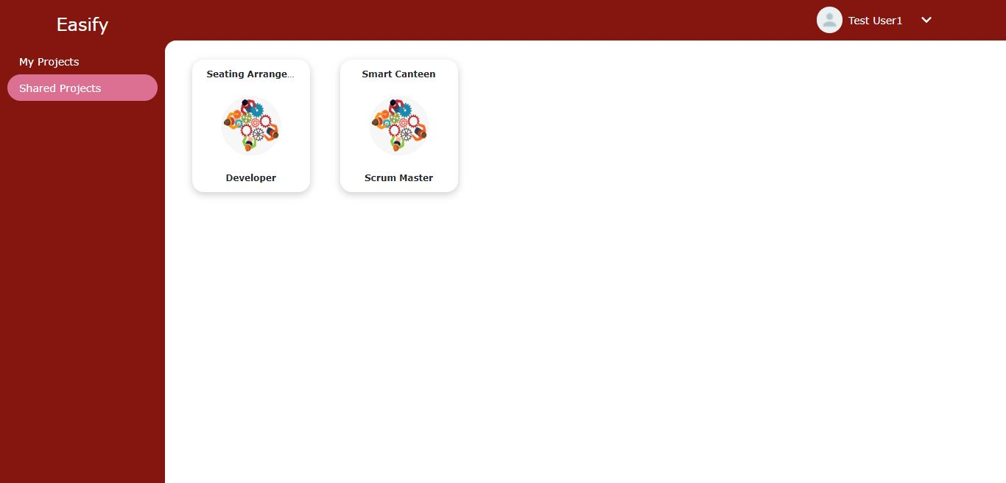
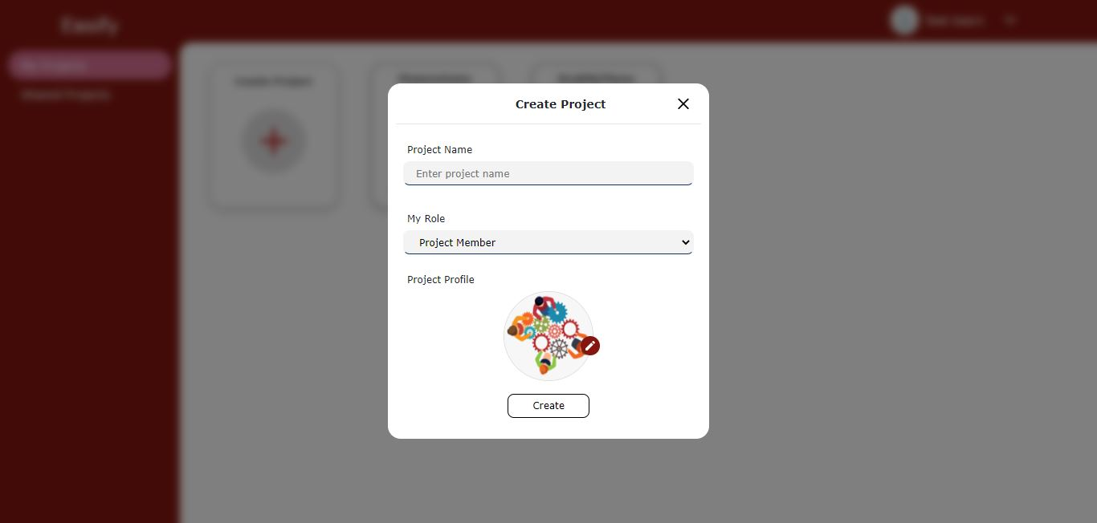
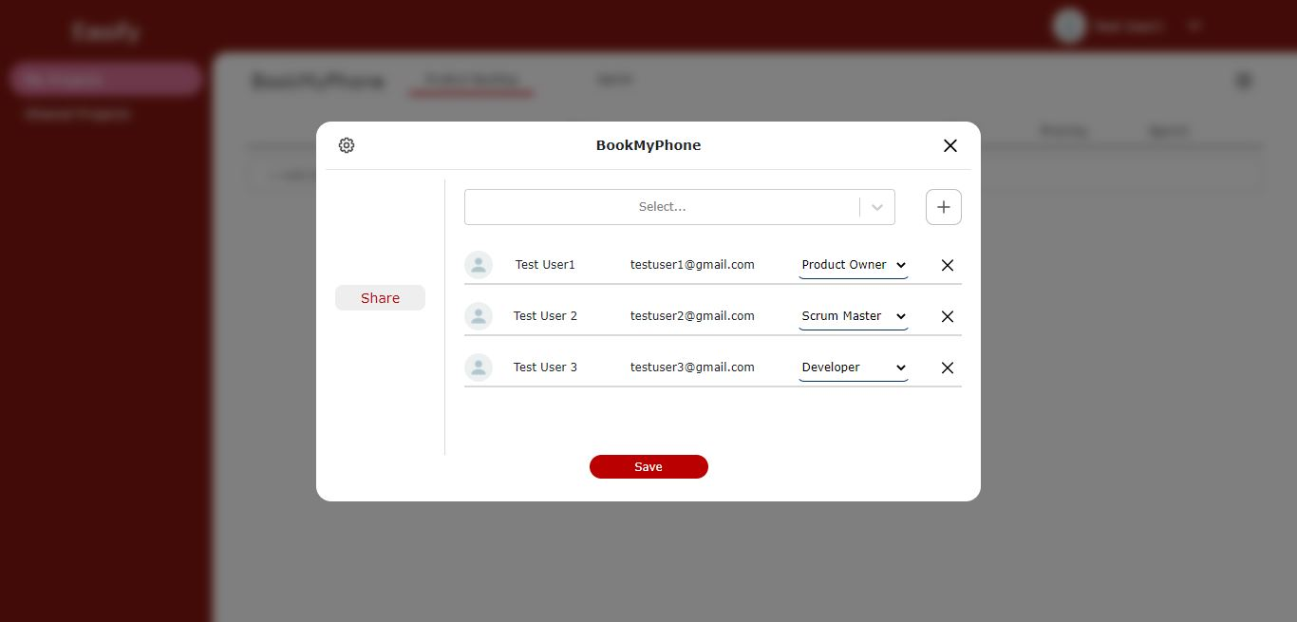
Sprint - 2: Results
My Project Page
Shared Project Page
Create Project
Project Settings

Slide 22
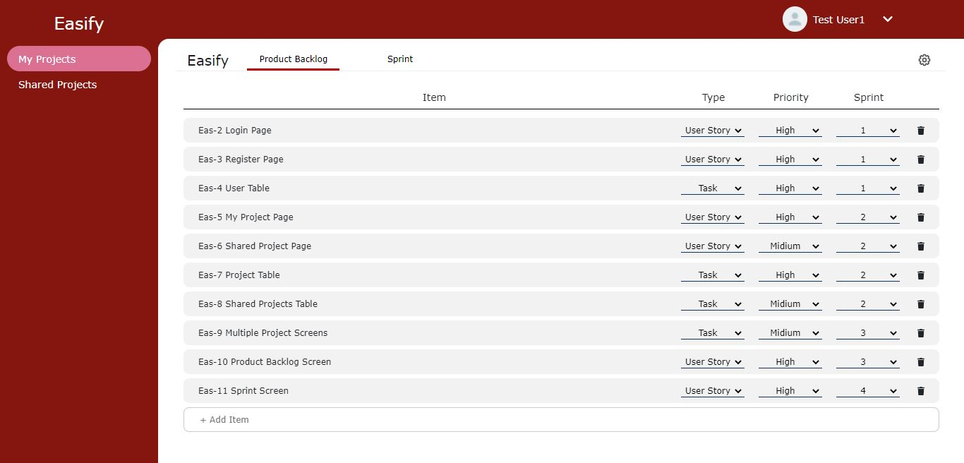
Sprint - 3 (March 31 - April 21)
ID | Item | Priority | Story Points | Status
EAS-15 | As a user, I want to be able to see the product backlog screen so that I can see the requirements of the project | High | 5 | Done
EAS-16 | As a creator of the project or product owner, I want to be able to add/ modify tasks into the backlog so that I can list out functionalities of the project | High | 3 | Done
EAS-17 | As a creator of the project, I want to be able to change the task’s priority (low, medium, high) so that other members can see the priorities | High | 2 | Done
EAS-18 | As a scrum master or developer or creator of the project, I want to be able to change the task’s type (User Story, Task, Bug) so that other members can see the type of the tasks | Mid | 1 | Done
EAS-51 | Integrate product backlog page with backend | High | NA | Done
EAS-52 | Create tech paper for Deliverable - 3 | Mid | NA | Done
EAS-53 | Update Github Wiki page | Mid | NA | Done
Product Backlog Page

Slide 23
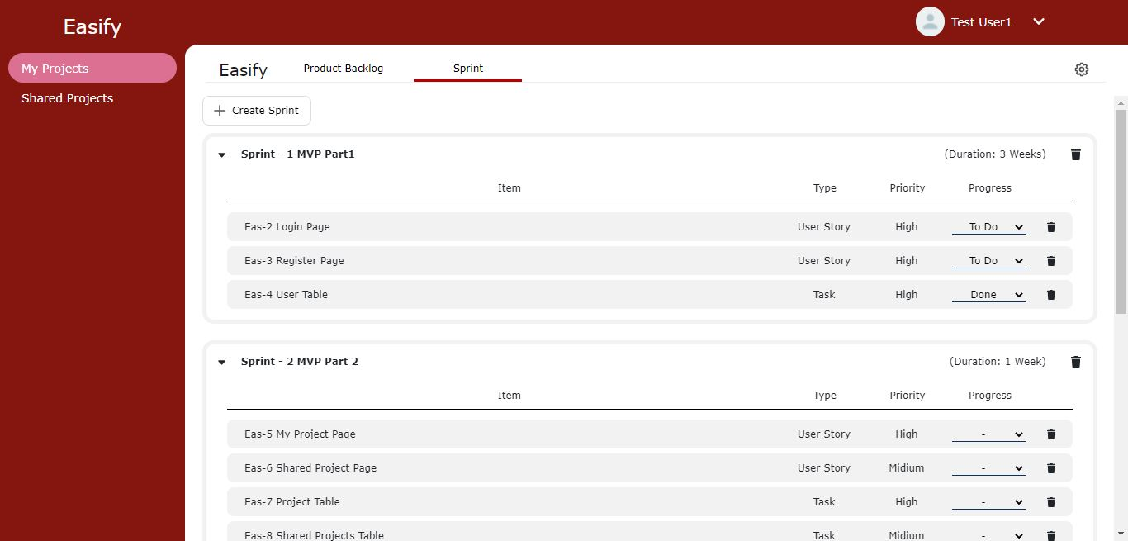
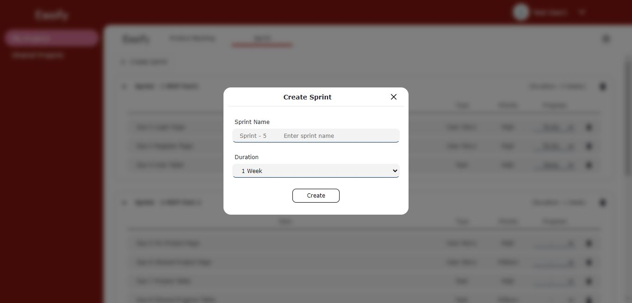
Sprint - 4 (April 22 - May 5)
ID | Item | Priority | Story Points | Status
EAS-19 | As a scrum master or creator of the project, I want to be able to create the sprint and the sprint backlog so that I can identify the work for the sprint | High | 3 | Done
EAS-20 | As a scrum master or developer or creator of the project, I want to be able to add/ modify tasks to the sprint backlog so that I can list out the work for the sprint | High | 3 | Done
EAS-21 | As a developer or creator of the project, I want to be able to change the task status (to do, in progress, done) so that other members can see the progress | High | 1 | Done
EAS-57 | Integrate sprint page with backend | High | NA | Done
EAS-58 | Create presentation for Deliverable - 4 | Mid | NA | Done
EAS-59 | Create video for Deliverable - 4 | Mid | NA | Done
EAS-60 | Create demo video of Easify | Mid | NA | Done
EAS-61 | Update Github Wiki page | Mid | NA | Done
Sprint Page
Create Sprint

Slide 24

Sprint 5-7 Recap
Sprint Backlogs

Slide 25
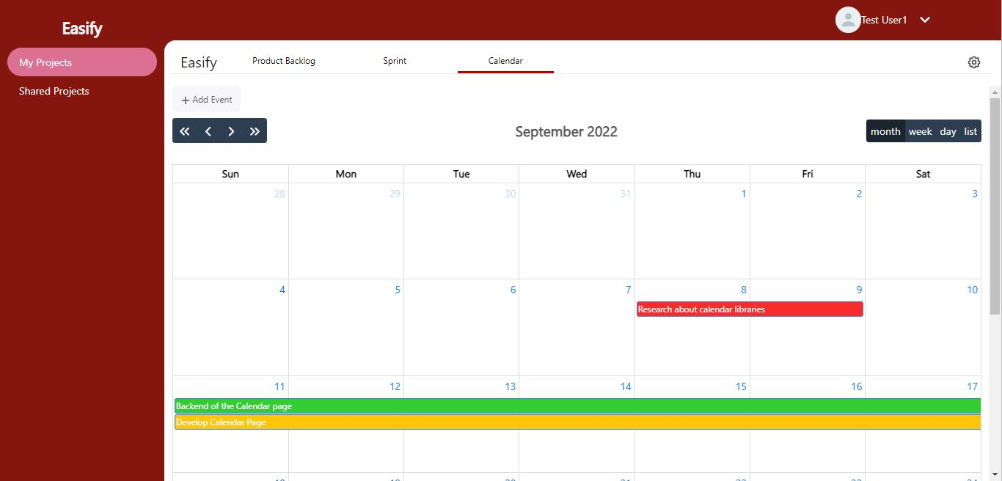
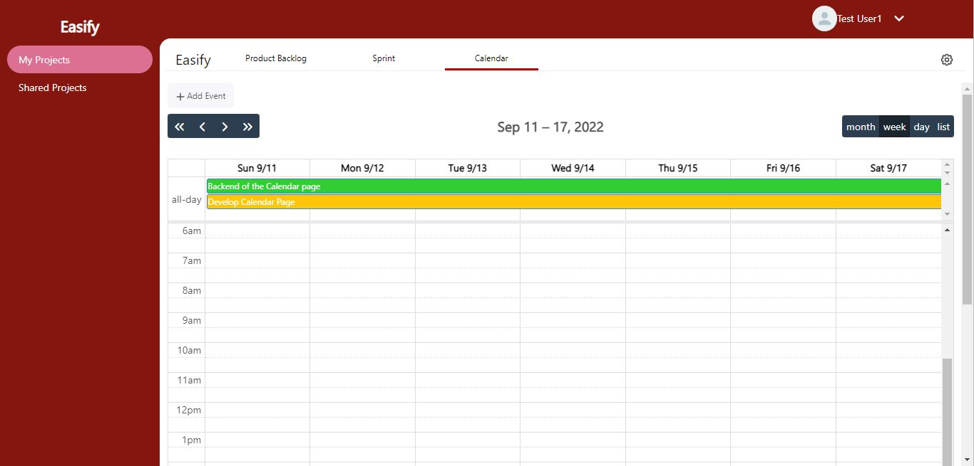
Sprint - 5 (Sep 8 - Sep 28)
ID | Item | Priority | Story Points | Status
EAS-25 | As a product owner or scrum master or developer or creator, I want to be able to see the calendar so that I can plan our work | Mid | 5 | Done
EAS-26 | As a product owner or scrum master or developer or creator, I want to be able to add/delete task on any date so that I can put/remove the deadline for that task | Mid | 5 | Done
EAS-64 | Integrate Calendar with Project screens and APIs | High | NA | Done
EAS-65 | Testing for Sprint - 5 | Mid | NA
EAS-66 | Create presentation for Deliverable - 5 | Low | NA | Done
EAS-67 | Create presentation video and demo for Deliverable - 5 | Mid | NA | Done
EAS-68 | Update Tech Paper | Mid | NA | Done
EAS-69 | Update Github Wiki page | Mid | NA | Done
Calendar Month View
Calendar Week View

Slide 26

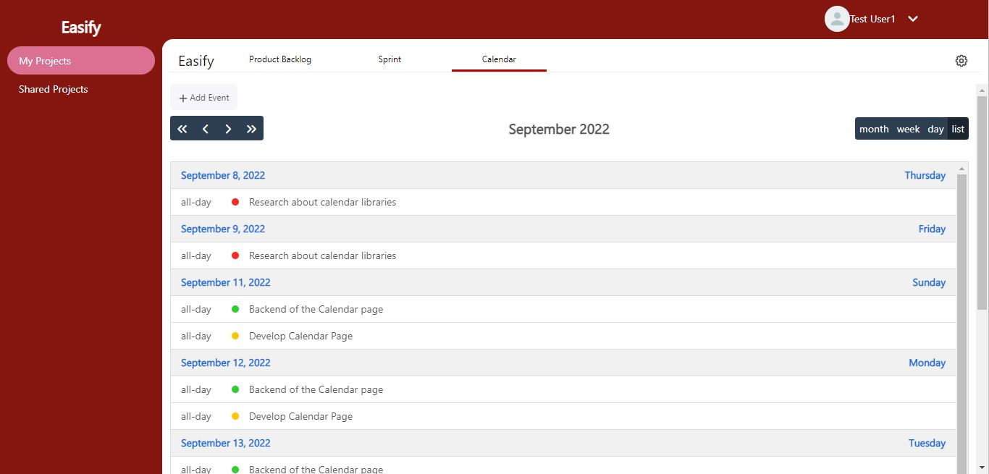
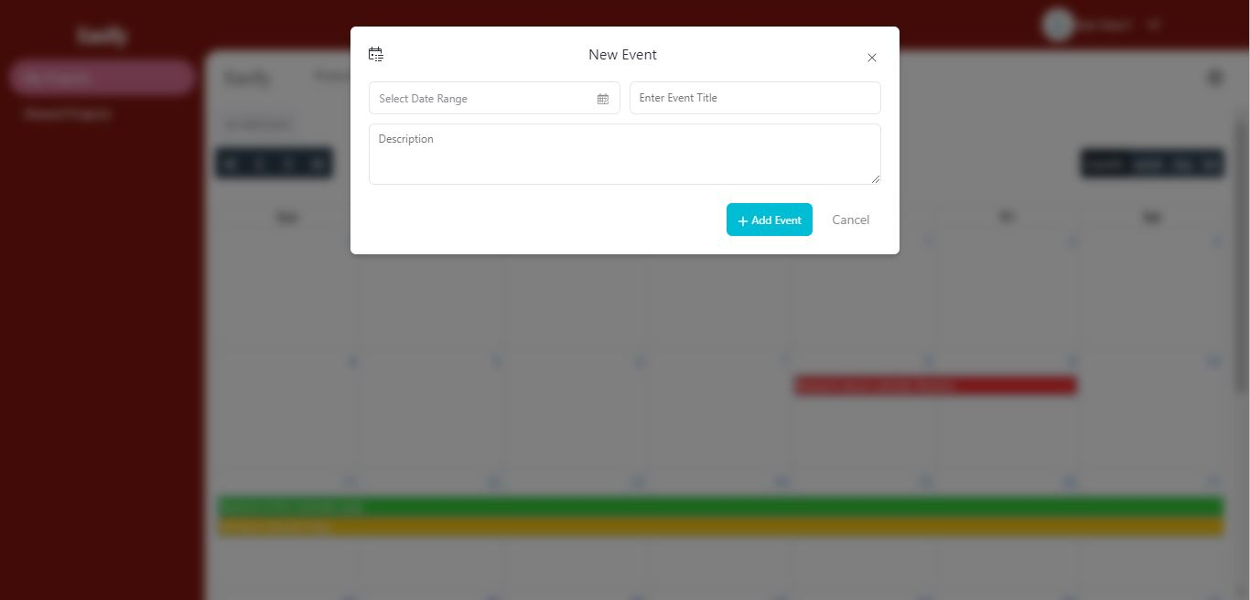
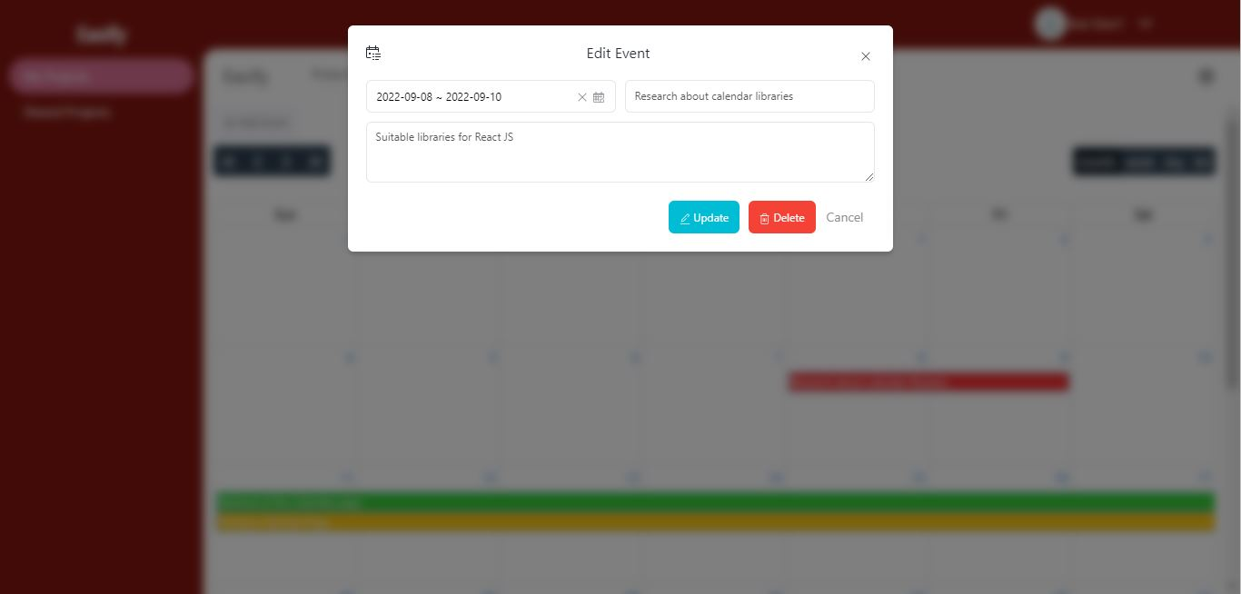
Sprint - 5: Results
Calendar Day View
Calendar List View
Calendar Add Event
Calendar Update-Delete Event

Slide 27
Sprint - 6 (Sep 29 - Nov 2)
ID | Item | Priority | Story Points | Status
EAS-70 | As a developer or creator, I want to be able to upload the images so that I can save my outcome or a problem | Mid | 3 | Done
EAS-71 | As a developer or creator, I want to be able to see the images uploaded by me or other members so that I can see which photos are uploaded | Mid | 2 | Done
EAS-72 | As a developer or creator, I want to be able to perform some operations (like fullscreen preview, rotate, zoom in-out, flip, download) on the images so that I can perform these operations within the system itself | Mid | 5 | Done
EAS-73 | As a developer or creator, I want to be able to delete the uploaded images so that I can remove unnecessary/ wrong photos | Mid | 2 | Done
EAS-74 | As a product owner or scrum master or creator, I want to be able to create user activity map for the project so that I can understand the user activities better | Mid | 5 | Done
EAS-75 | As a product owner or scrum master or creator, I want to be able to edit/ delete user activity map so that I can modify the user activities | Mid | 3 | Done
EAS-76 | As a product owner or scrum master or creator, I want to be able to download user activity map so that I can share it with other people | Mid | 2 | Done
EAS-79 | Setup the AWS S3 bucket with Laravel Backend | Mid | NA | Done
EAS-81 | Integrate Attachment and Activity Map with Project screens and Backend APIs | High | NA | Done
EAS-82 | Testing for Sprint - 6 | Mid | NA | Done
EAS-83 | Create presentation for Deliverable - 6 | Low | NA | Done
EAS-84 | Create presentation video and demo video for Deliverable - 6 | Mid | NA | Done
EAS-85 | Update Tech Paper | Low | NA | Done
EAS-86 | Update Github Wiki page | Low | NA | Done

Slide 28
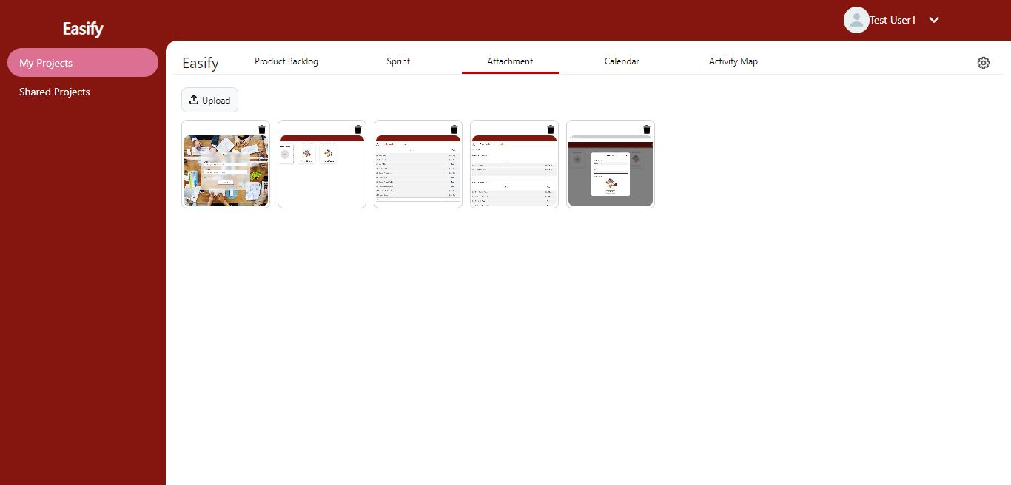
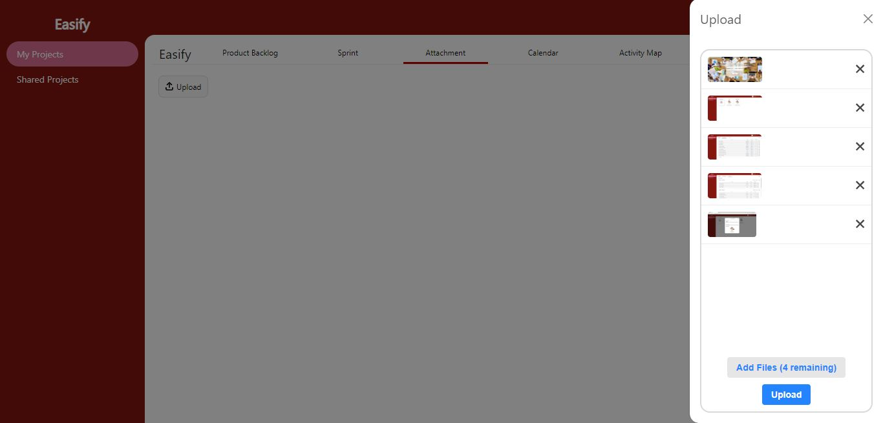
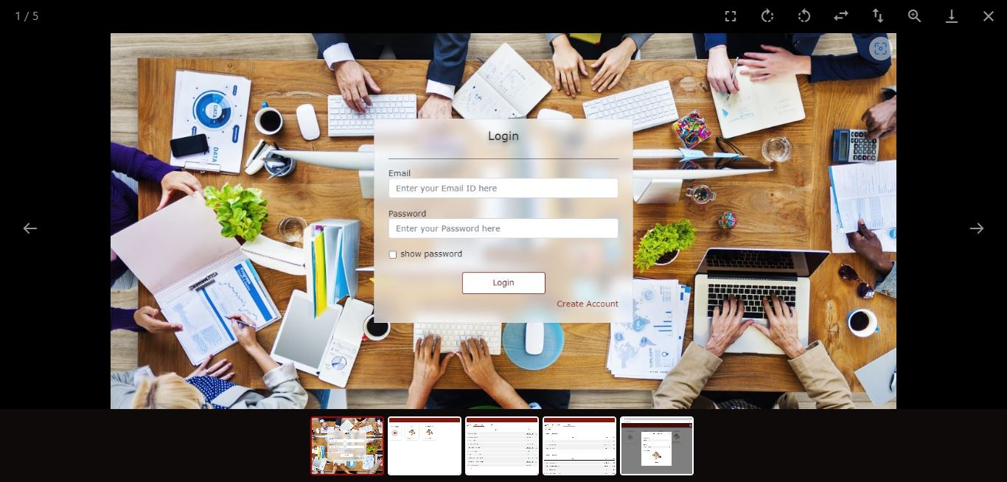
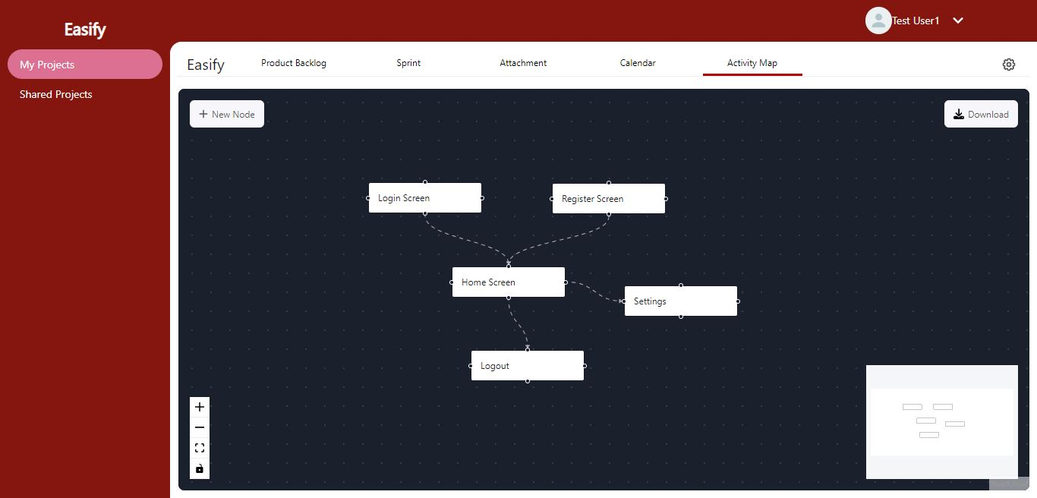
Sprint - 6: Results
Attachment Page
Attachment Page - Upload Dropzone
Attachment Page - Photo Preview
Activity Map Page

Slide 29
Sprint - 7 (Nov 3 - Nov 30)
ID | Item | Priority | Story Points | Status
EAS-87 | As a product owner or scrum master or developer or creator, I want to be able to see the chat group for the projects so that I can chat with others about the project | Mid | 3 | Done
EAS-88 | As a product owner or scrum master or developer or creator, I want to be able to send messages in project group so that I can notify others about tasks or bugs | Mid | 8 | Done
EAS-89 | As a product owner or scrum master or developer or creator, I want to be able to receive the messages from project group so that we can interact with each other and keep track of the work | Mid | 8 | Done
EAS-90 | As a product owner or scrum master or developer or creator, I want to be able to see the previous messages of project chat group so that I can see the previously discussed things on the project chat group | Mid | 2 | Done
EAS-91 | Redesign the UI | Mid | NA | Done
EAS-92 | Research about different chat libraries supporting ReactJs | High | NA | Done
EAS-93 | Integrate Chat Screen with Project screens and Backend APIs | High | NA | Done
EAS-94 | Testing for Sprint - 7 | Mid | NA | Done
EAS-95 | Create presentation for Deliverable - 7 | Low | NA | Done
EAS-96 | Create presentation video and demo video for Deliverable - 7 | Mid | NA | Done
EAS-97 | Update Tech Paper | Low | NA | Done
EAS-98 | Update Github Wiki page | Low | NA | Done

Slide 30
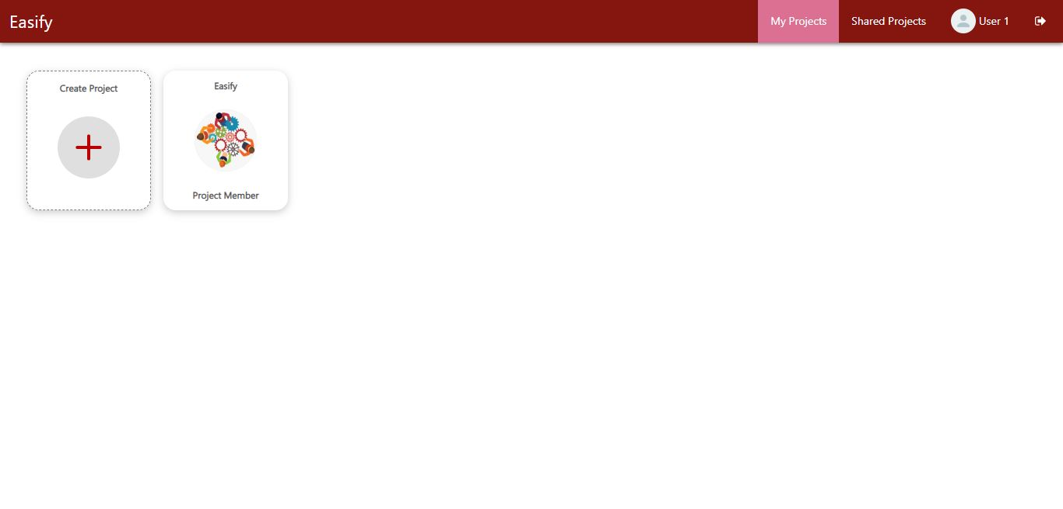
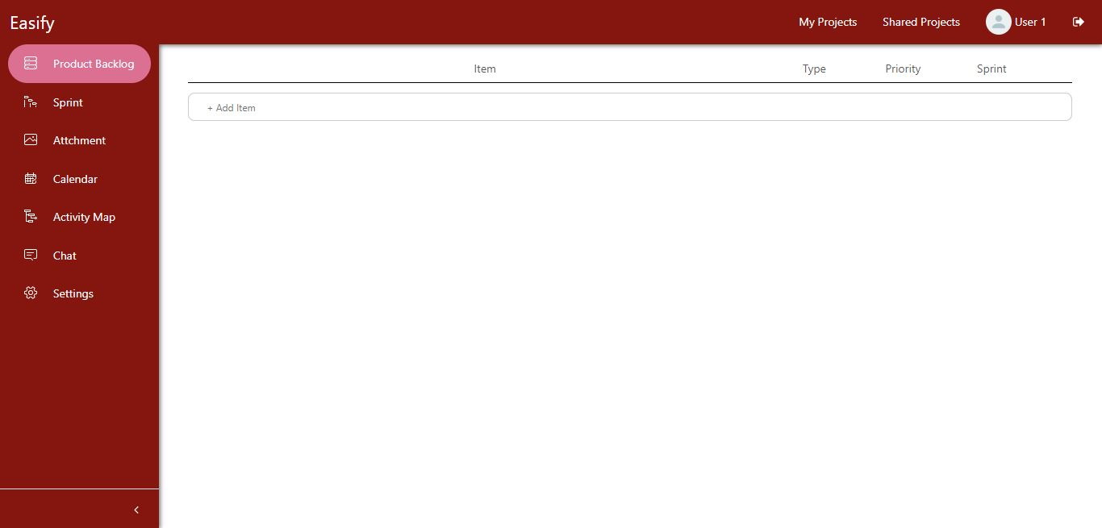
Sprint - 7: Results
New Design My Project/ Shared Project Page
Old Design My Project/ Shared Project Page
New Design of Project Subpages
Old Design of Project Subpages

Slide 31
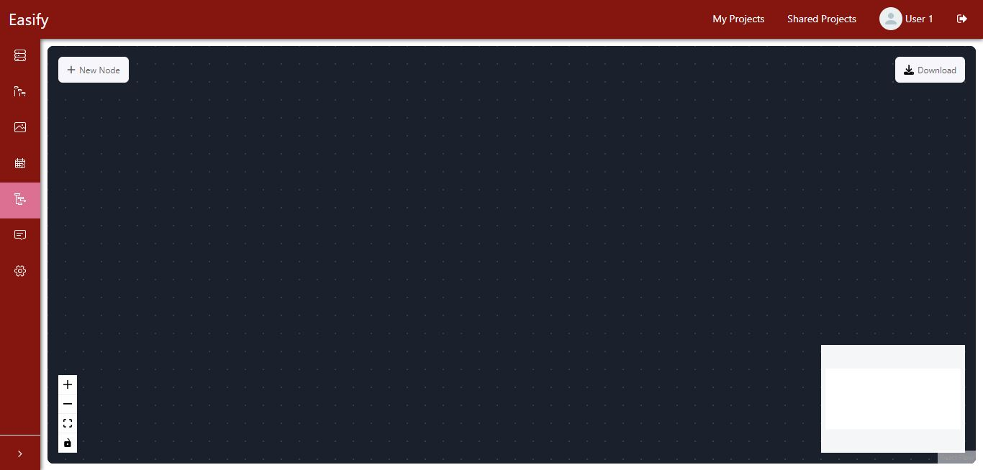
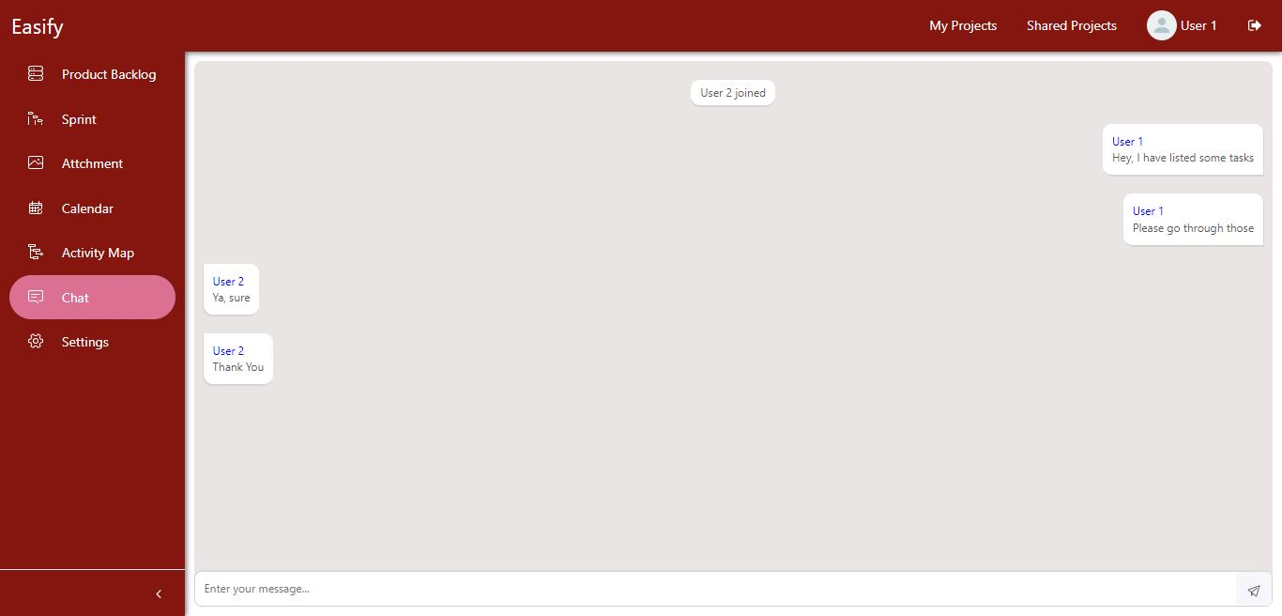
Sprint - 7: Results Continue
New design of Side Panel
Old design of Side Panel
Project Chat Page
Users can chat with shared members. Each project has its own chat screen.

Slide 32
Sprint 7
Sprint 8
Completed feature: Chat
New design
We developed the frontend and backend for the Chat feature
Easify will create a chat group while creating the project
Easify users can chat with project members
Each project has its own chat screen
Easify users can now open any feature by going to feature’s unique url
Completed feature: Email Authentication, Forgot Password, Profile Settings, Project Settings
Database live on AWS Server
We developed the frontend and backend for the above feature
Easify users can change their password using email authentication
Project can be share-unshare with other users
Forgot password feature is also there

Slide 33
Improvement from the Professor’s Feedback
Write slide number in the “Improvement from the Professor’s Feedback” slide for each improvement - slide 33
Show current sprint user stories and future sprint user stories in product backlog - slide 34
Write more details in retrospective - slide 45

Slide 34
Product Backlog
ID | Feature | Item | Priority | Sprint | Status
EAS-2 | Register | As a new user, I want to be able to receive authentication email so that the system can authenticate me | Mid | Sprint 8 | Done
EAS-4 | Login | As a registered user, I want to be able to request for change the password if I forgot it so that I don't lose my account and data | Mid | Sprint 8 | Done
EAS-6 | Profile Settings | As a user, I want to be able to edit my details such as name and profile photo so that I can edit my profile | Low | Sprint 8 | Done
EAS-7 | Profile Settings | As a user, I want to be able to change my password so that I can keep my account secure | Low | Sprint 8 | Done
EAS-13 | Project Settings | As a creator of the project, I want to be able to change the project profile photo, so that I can update project photo | Mid | Sprint 8 | Done

Slide 35

Sprint 8

Slide 36
Sprint - 8: Sprint Backlog
ID | Item | Priority | Story Points | Status
EAS-2 | As a new user, I want to be able to receive authentication email so that the system can authenticate me | Mid | 5 | Done
EAS-4 | As a registered user, I want to be able to request for change the password if I forgot it so that I don't lose my account and data | Mid | 5 | Done
EAS-6 | As a user, I want to be able to edit my details such as name and profile photo so that I can edit my profile | Low | 3 | Done
EAS-7 | As a user, I want to be able to change my password so that I can keep my account secure | Low | 3 | Done
EAS-13 | As a creator of the project, I want to be able to change the project profile photo, so that I can update project photo | Mid | 3 | Done
EAS-99 | Integrate Authentication page with Register and Login screen and backend APIs | Mid | NA | Done
EAS-100 | Integrate Profile Settings with main UI | Mid | NA | Done
EAS-101 | Integrate Project Settings with project screens and backend APIs | Mid | NA | Done
EAS-102 | Redesign the UI and redirections | Low | NA | Done
EAS-103 | Host database on AWS | Mid | NA | Done
EAS-104 | Testing for Sprint - 8 | Mid | NA | Done
EAS-105 | Create presentation for Deliverable - 8 | Low | NA | Done
EAS-106 | Create presentation video and demo video for Deliverable - 8 | Mid | NA | Done
EAS-107 | Update Tech Paper | Low | NA | Done
EAS-108 | Update Github Wiki page | Low | NA | Done

Slide 37
Sprint - 8: Committed and Completed User Stories
Total 19 Story Points
100% Completed
User Story: As a new user, I want to be able to receive authentication email so that the system can authenticate me
Acceptance Criteria:
• Given user entered right OTP, when user click on register button, then account should be created
• Given user entered wrong OTP, when user click on register button, then system has to display error message
EAS-2
Points - 5
User Story: As a user, I want to be able to edit my details such as name and profile photo so that I can edit my profile
Acceptance Criteria:
• Given user is on profile page, when user click on edit photo and try to upload image from personal device, then system should accept image file
• Given on profile page and name field is empty, when user click on update profile, then system should display error message
• Given on profile page user did not select any photo, when user click on update profile, then system should take default profile avatar photo
EAS-6
Points - 3
User Story: As a registered user, I want to be able to request for change the password if I forgot it so that I don't lose my account and data
Acceptance Criteria: Given user forgot the password, when user click on forgot password, then system should ask for new password, confirm password and OTP and user should receive OTP through email
EAS-4
Points - 5

Slide 38
Sprint - 8: Committed and Completed User Stories
Total 19 Story Points
100% Completed
User Story: As a user, I want to be able to change my password so that I can keep my account secure
Acceptance Criteria: Given user is on profile page, when user click on change password, then system should ask for new password, confirm password and OTP and user should receive OTP through email
User Story: As a creator of the project, I want to be able to change the project profile photo, so that I can update project photo
Acceptance Criteria:
• Given user is creator of the project, when user change the photo, then system should accept image file and photo should be updated in database
• Given user is not creator of the project, when user try to change project settings, then system should not allow to change the project settings
EAS-7
Points - 3
EAS-13
Points - 3

Slide 39
Sprint - 8: Test Cases
ID | User Story ID | Feature | Test Case | Expected Output | Actual Outcome | Status
EAST-47 | EAS-2 | Register | User clicks on register button | User should be able to receive the OTP through email | User is able to receive the OTP through email | Pass
EAST-48 | EAS-2 | Register | Entered OTP is correct | Account should be created | User's account is created | Pass
EAST-49 | EAS-2 | Register | Entered OTP is incorrect | System should display the error message | System display the error message | Pass
EAST-50 | EAS-4 | Login | User clicks on forgot password | System should redirect to forgot password page | System redirects to forgot password page | Pass
EAST-51 | EAS-6 | Profile | User wants to edit profile photo | User should be able to edit profile photo | User is able to edit profile photo | Pass
EAST-52 | EAS-6 | Profile | On profile page, any required details is blank | Error message should be display | System display the error message | Pass
EAST-53 | EAS-6 | Profile | Photo not uploaded by user | System should display the default avatar photo | System display the default avatar photo | Pass
EAST-55 | EAS-7 | Profile | User clicks on change password | User should be able to receive the OTP through email | User is able to receive the OTP through email | Pass
EAST-56 | EAS-13 | Project Settings | User wants to change the project profile photo | User should be able to change the project profile photo | User is able to change the project profile photo | Pass

Slide 40
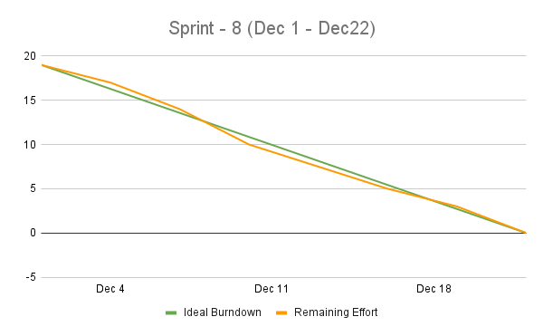
Sprint - 8: Burndown Chart

Slide 41
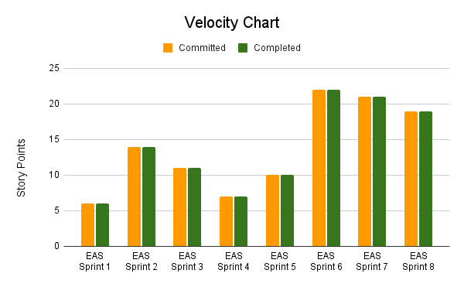
Velocity
Average Velocity
= (6+14+11+7+10+22+21+19)/8
= 13.75

Slide 42
Completed Committed Ratio
Sprint | Committed | Completed | Ratio
EAS Sprint 1 | 6 | 6 | 100.00%
EAS Sprint 2 | 14 | 14 | 100.00%
EAS Sprint 3 | 11 | 11 | 100.00%
EAS Sprint 4 | 7 | 7 | 100.00%
EAS Sprint 5 | 10 | 10 | 100.00%
EAS Sprint 6 | 22 | 22 | 100.00%
EAS Sprint 7 | 21 | 21 | 100.00%
EAS Sprint 8 | 19 | 19 | 100.00%
Average Completed Committed Ratio = 100.00%
Current Completed Committed Ratio (Sprint 8) = 100.00%

Slide 43
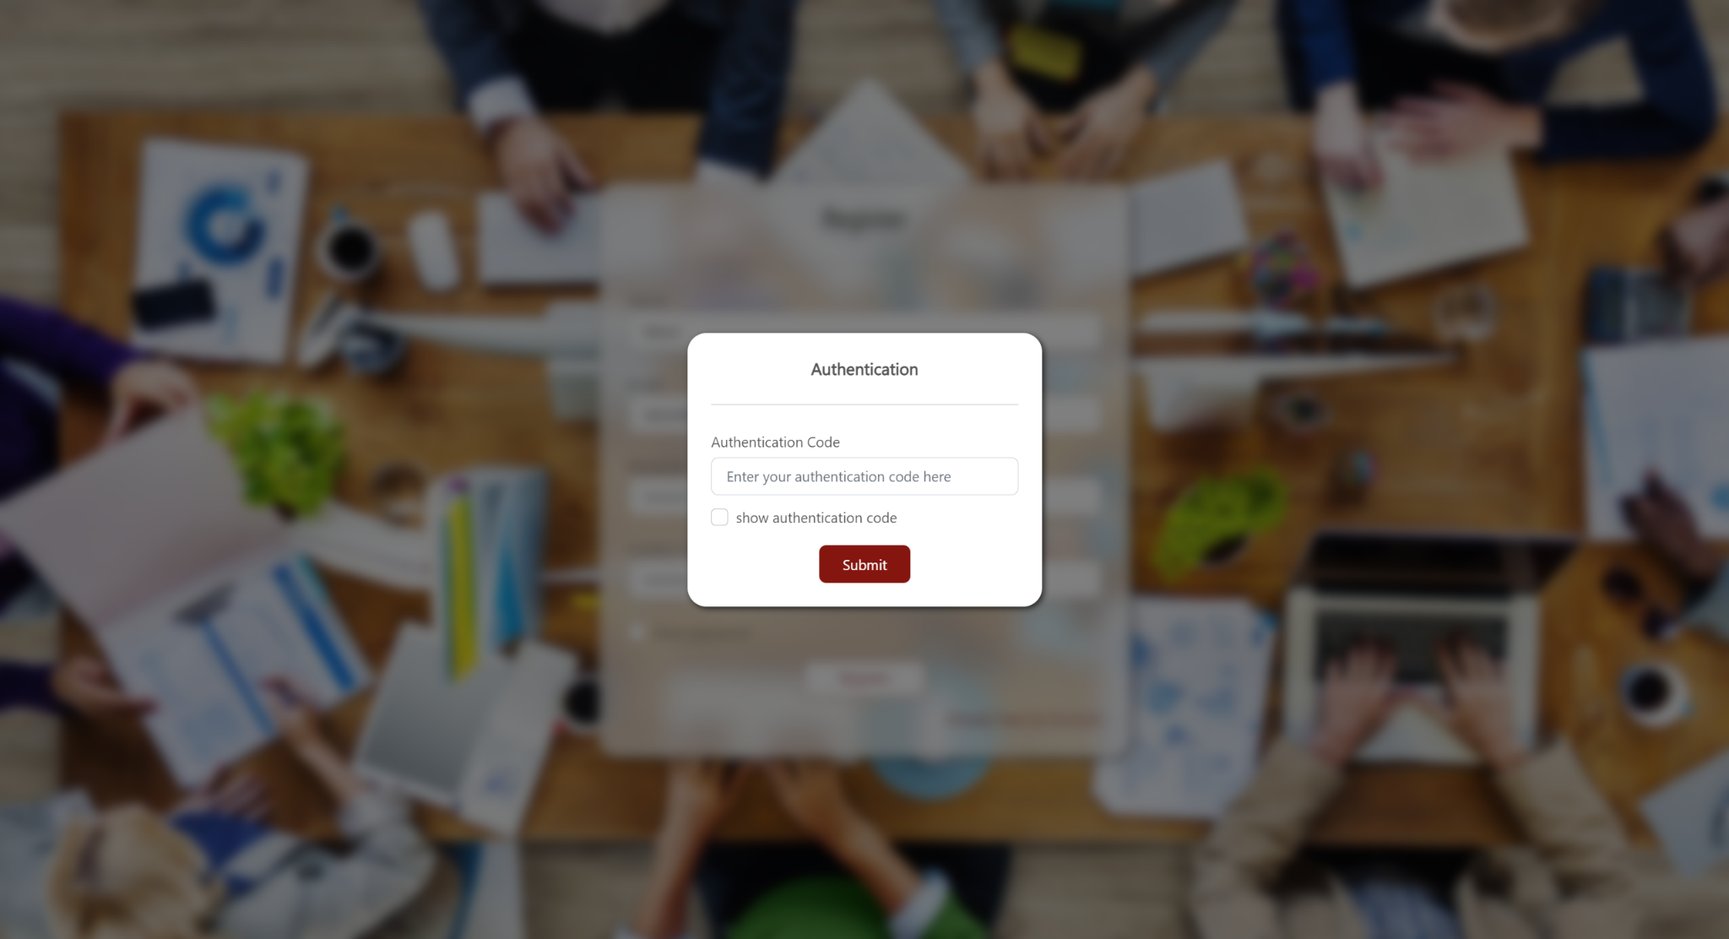
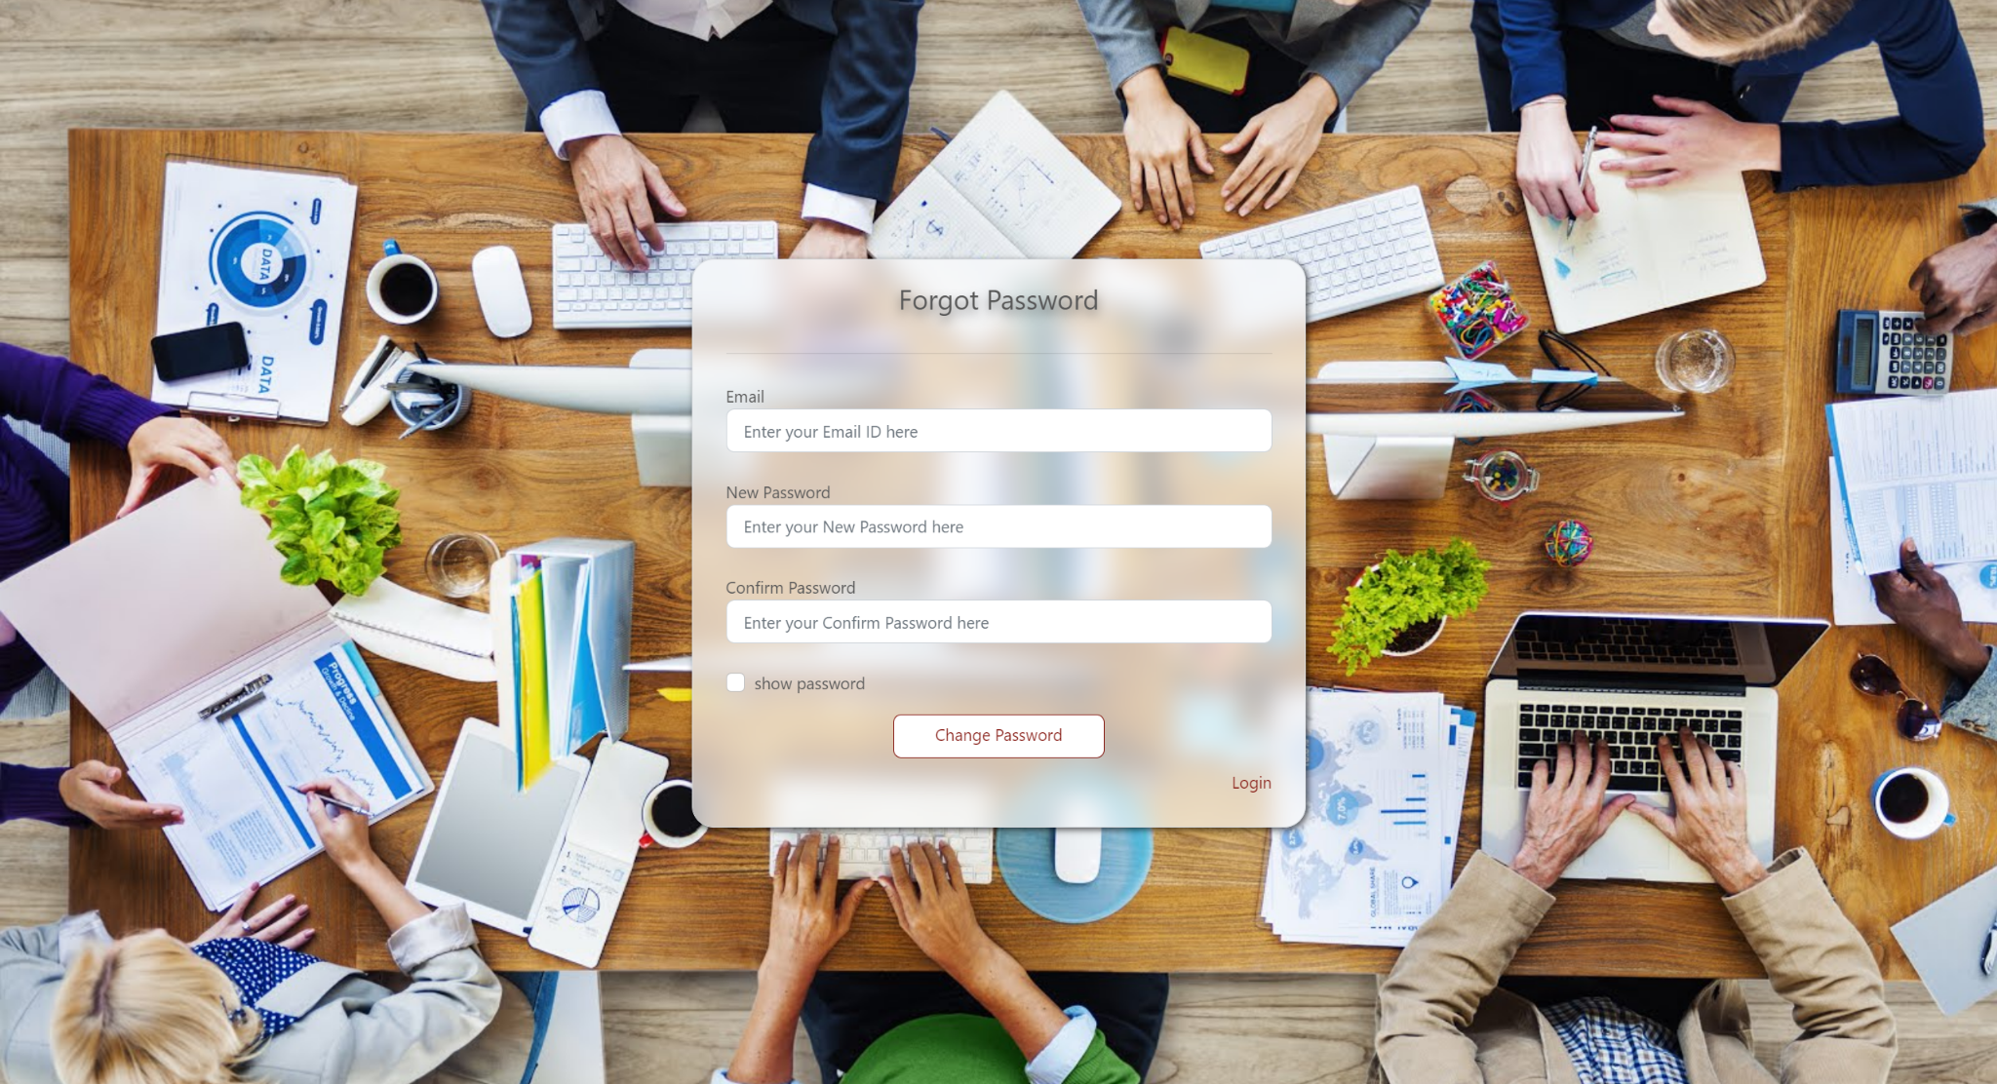
Sprint - 8: Results
Authentication Code Popup
While registering in the Easify, users have to authenticate themselves by Email verification.
Forgot Password Page
Now users can get there account back using forgot password functionality.

Slide 44
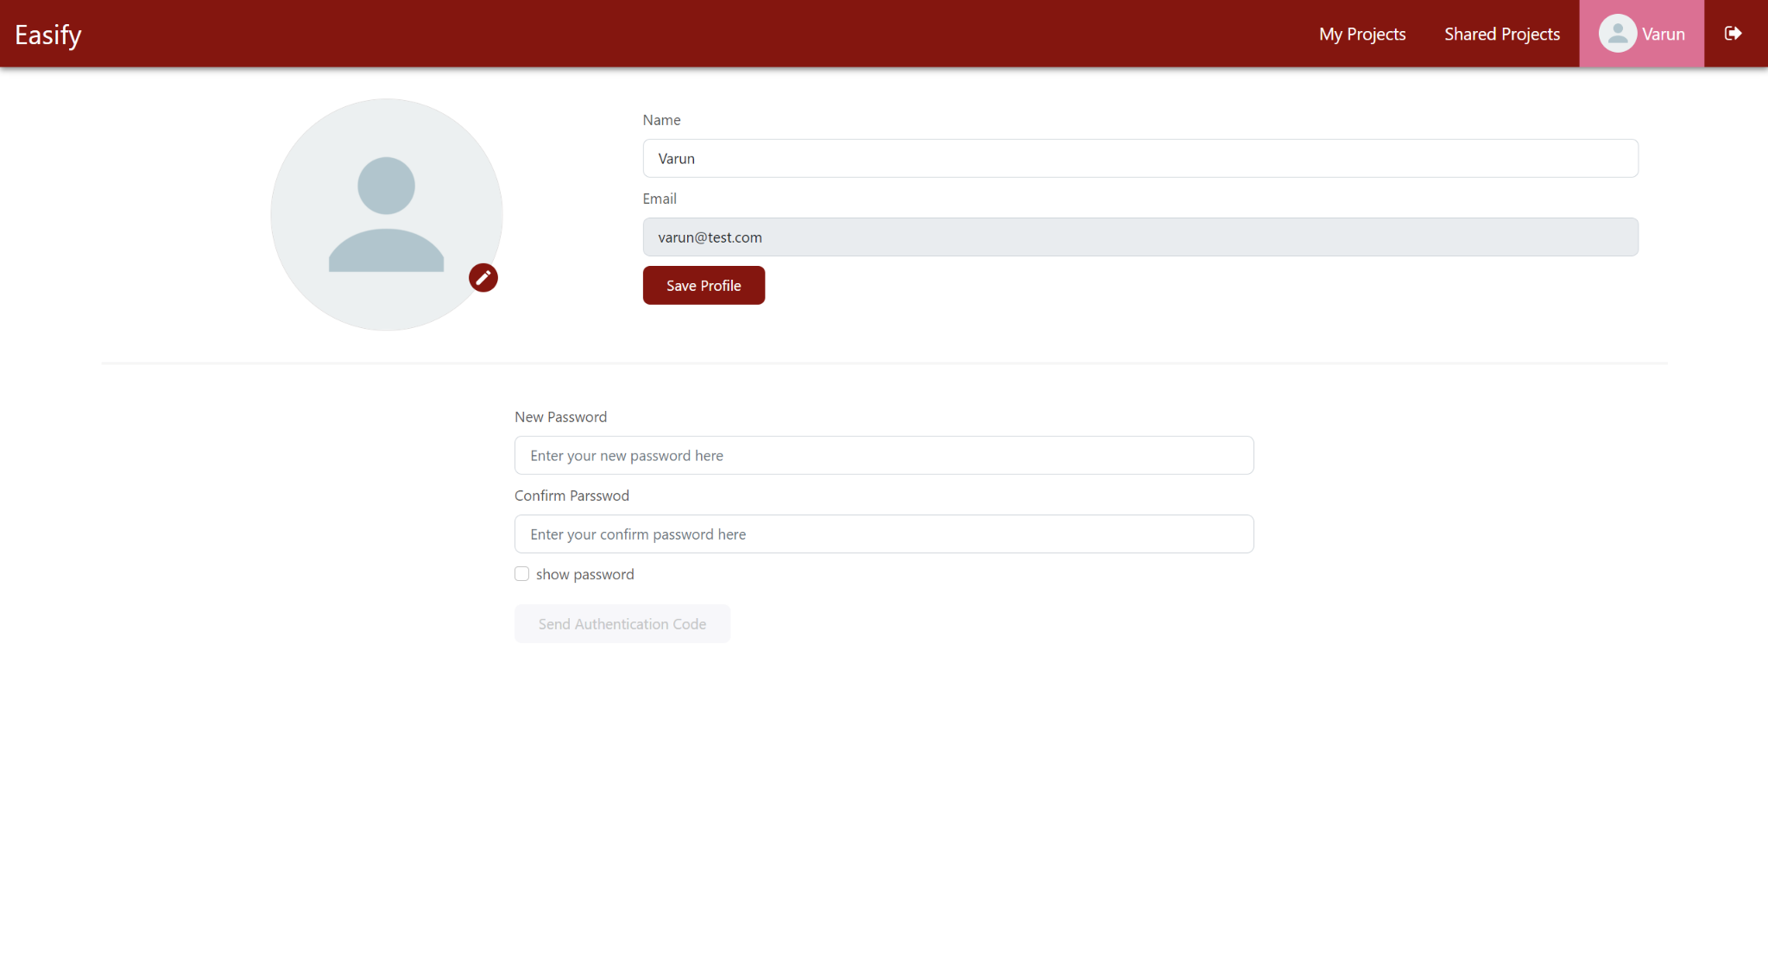
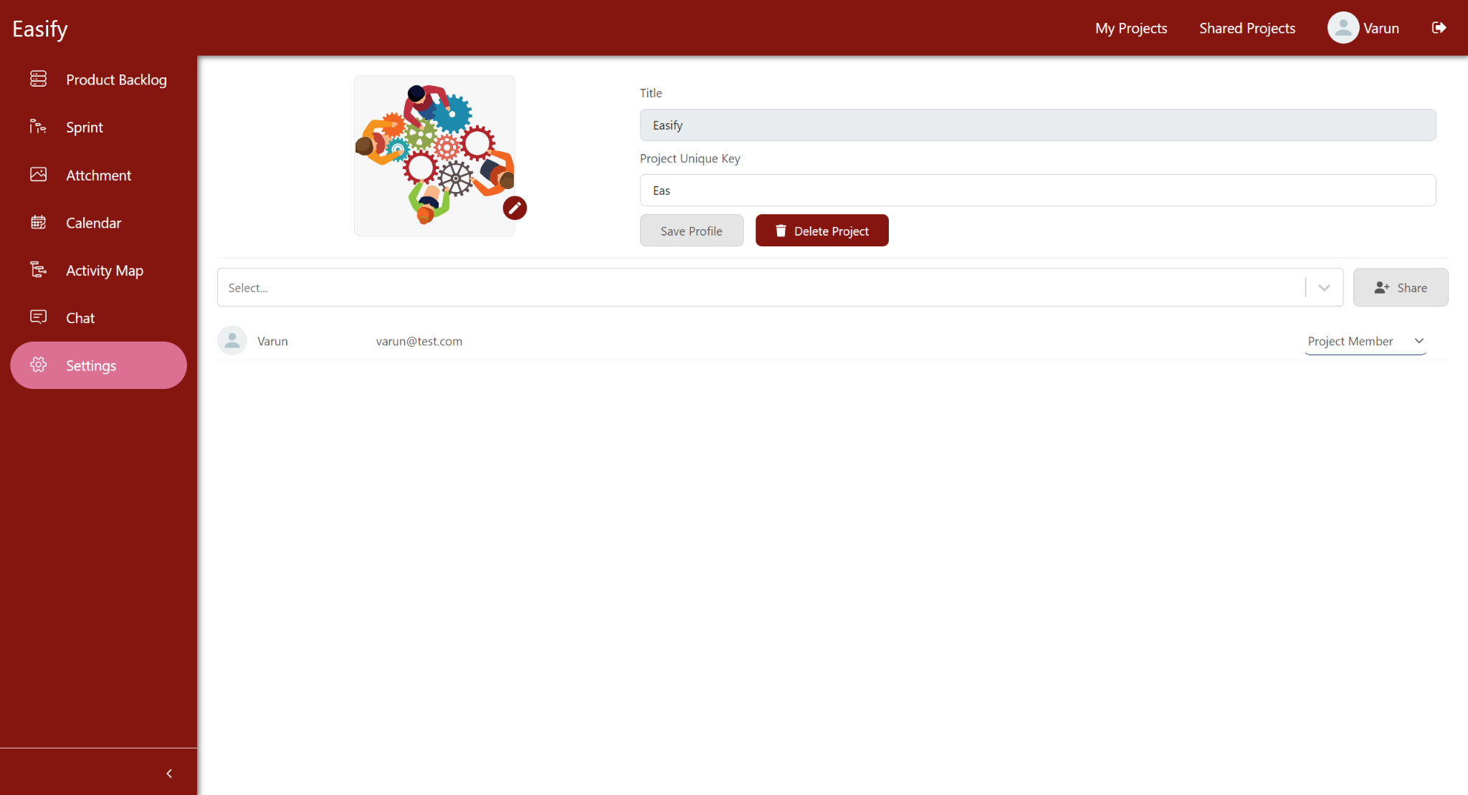
Sprint - 8: Results Continue
Profile Page
User can edit their name and profile photo. Also they can change their password.
Project Setting Page
Users can edit the unique key and profile photo of the project. User can share-unshare or delete the project.

Slide 45
Retrospective
What went well
Code merge with GitHub and AWS Elastic Beanstalk
Learning and understanding about Agile and web technologies
What can be improved
Team meetings are not properly scheduled because of examination
Research and understanding about the cloud technologies
Action items
Do more research on cloud technologies

Slide 46
Future Scope
In the future, we can add new features that allow users to create user stories and create subtasks.
Giving users more control over the project, assigning any particular task to someone, giving some users access to modify the project and its settings, etc.
A separate page to show recents working projects and project members.

Slide 47

Group Wiki
https://github.com/DV192/Stonecrusher/wiki

Slide 48
Thank You

